Slide 1

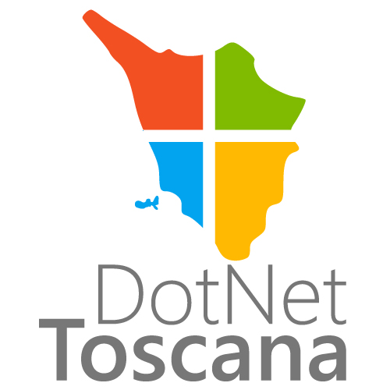
Visual studio <3 Microsoft Azure
Riccardo Cappello
https://about.me/rcappello
@rcappello

Slide 2
Azure development
Come aggiungerlo a VS

Slide 3
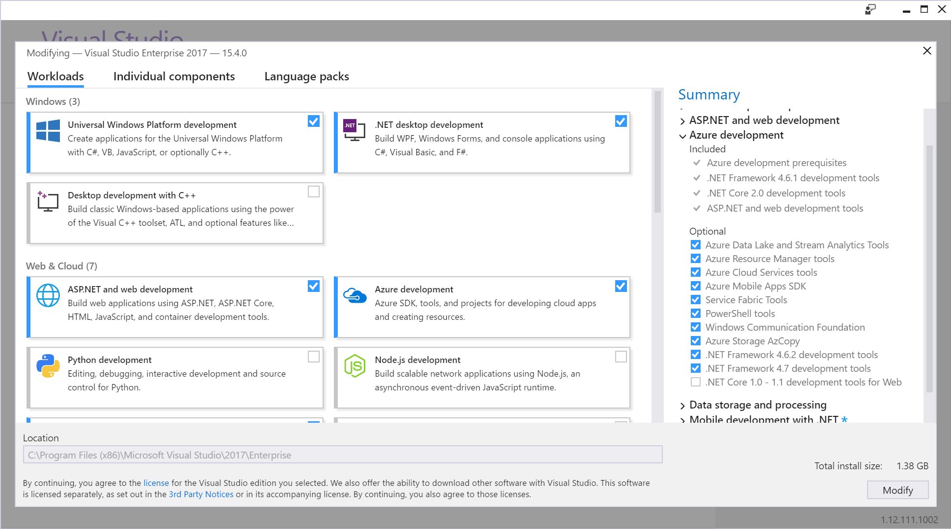
Notes:
Per aggiungere i componenti Azure Development è necessario usare Visual Studio Installer
TODO: Demo e visualizzazione degli individual components

Slide 4
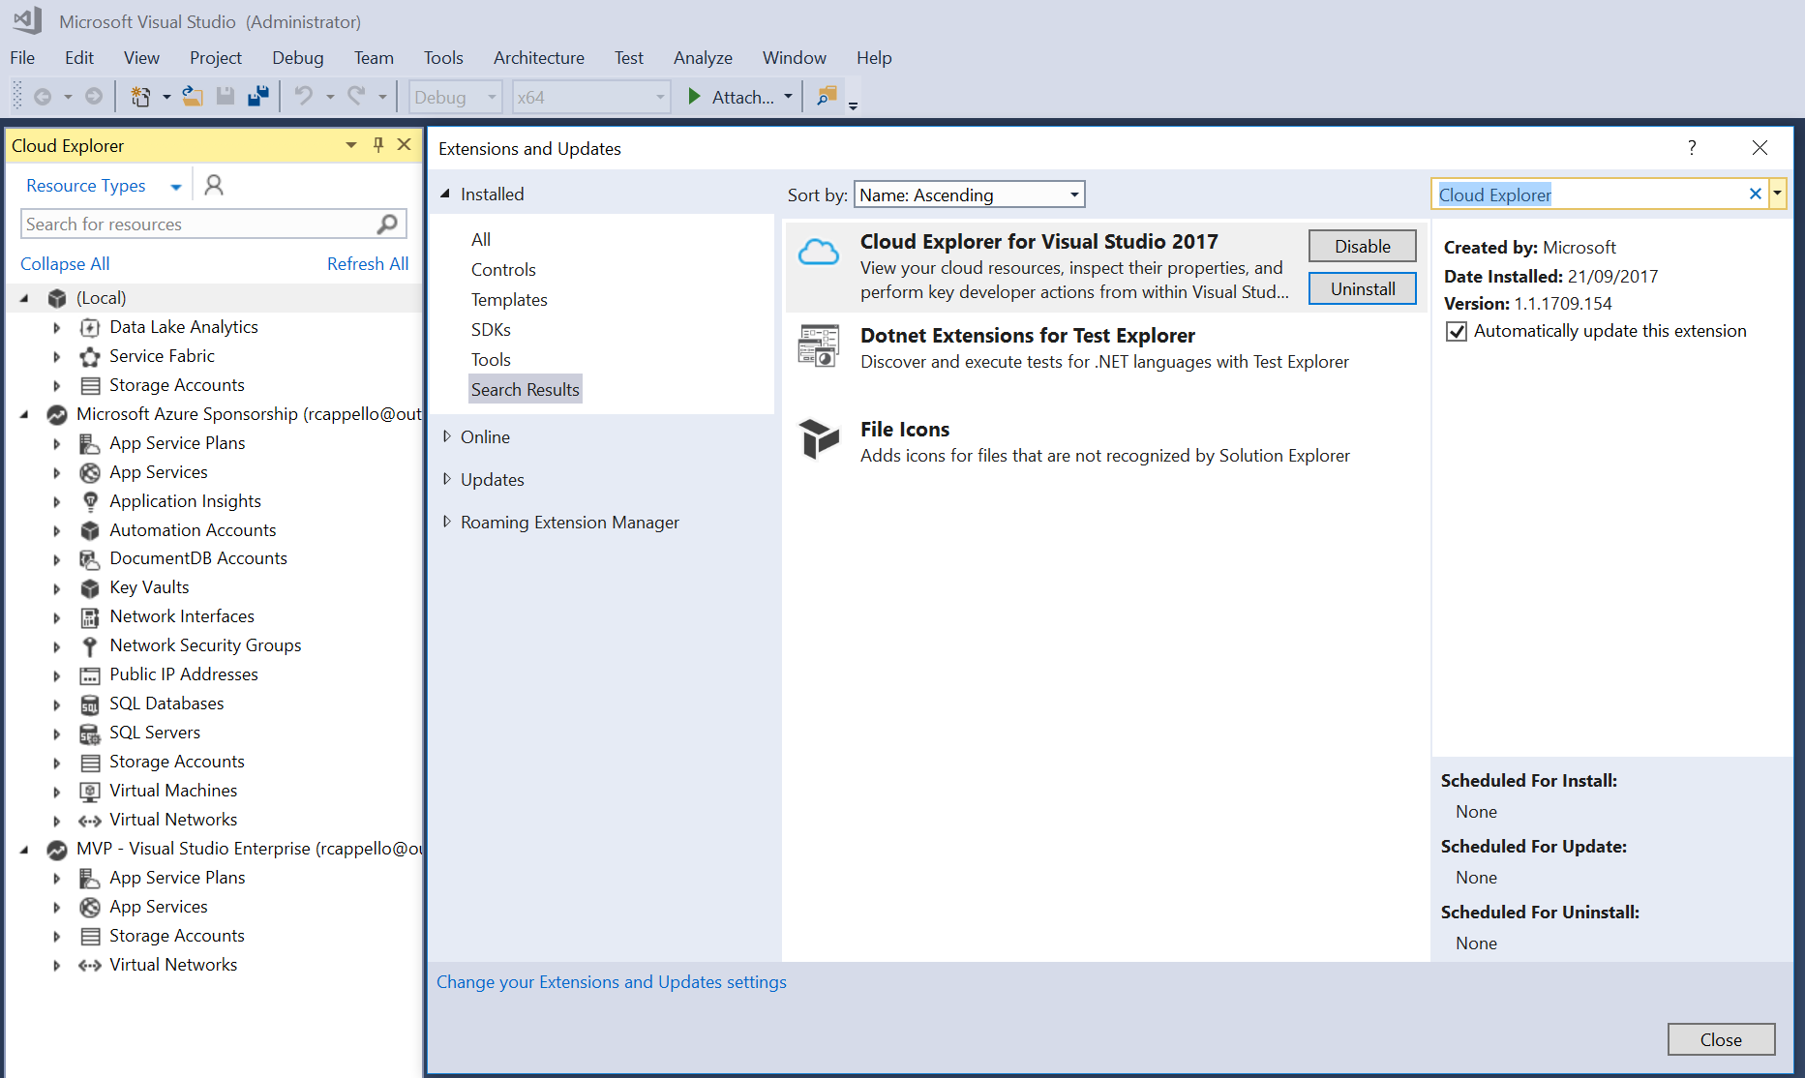
Cloud Explorer
Notes:
TODO: Demo di come si configura il cloud explorer e di cosa possiamo fare

Slide 5
App Service Tools
Le app web su Azure

Slide 6
The evolution of application platforms
On-Premises
IaaS
PaaS
Serverless

Slide 7
Before cloud
Which packages should
be on my server?
What is the right size of
servers for my business needs?
What happens in case of
server hardware failure?
How do I deploy new code to my server?
How can I increase server utilization?
What media should I
use to keep backup?
How can I scale my app?
What size of servers
should I buy?
Who monitors
my App?
How often should I backup my server?
Who monitors
my Servers?
What storage I need to use?
Which OS should I use?
Who has physical
access to my servers?
Are my server in a
secure location?
Do I need secondary
network connection?
How many servers
do I need?
Do I need a UPS?
What happens if the
power goes out?
How often should
I patch my servers?
How can I dynamically
configure my app?
It takes how long to provision a new server?

Slide 8
Then came IaaS—table stakes for digital business
What is the right size of servers for my business needs?
How can I increase server utilization?
How many servers do I need?
How can I scale my app?
How often should I patch my servers?
How do I deploy new code to my server?
How often should I backup my server?
Which OS should I use?
Which packages should be on my server?
Who monitors my App?

Slide 9
Then PaaS, critical for digital transformation
What is the right size of “servers” for my business needs?
How can I increase “server” utilization?
How many “servers” do I need?
How can I scale my app?

Slide 10





Industry-leading Application PaaS Platform
SOLUTIONS
Transactional
Apps
Digital
Marketing
LoB App
Modernization
SERVICES
Web Apps
Web App for Containers
API Apps
Mobile Apps
IDE
Enterprise Integration
Serverless compute
Data /Storage
Intelligence
Application Insights
PLATFORM
App Service
Fully Managed Platform • High Productivity Development • Enterprise Grade Apps

Slide 11

Azure App Service
Enterprise-grade apps
Fully managed platform
High productivity development
Global data center footprint
Hybrid support
Built-in auto scale and load balancing
High availability with auto-patching
.NET, Java, PHP, Node,
Ruby, and Python
Staging and deployment
AAD integrated
Secure + compliant
Reduced operations costs
Backup and recovery
Testing in production
App gallery marketplace

Slide 12
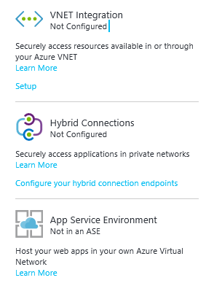
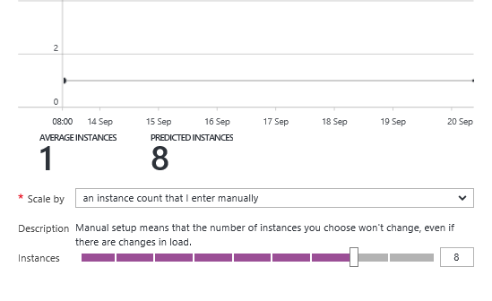
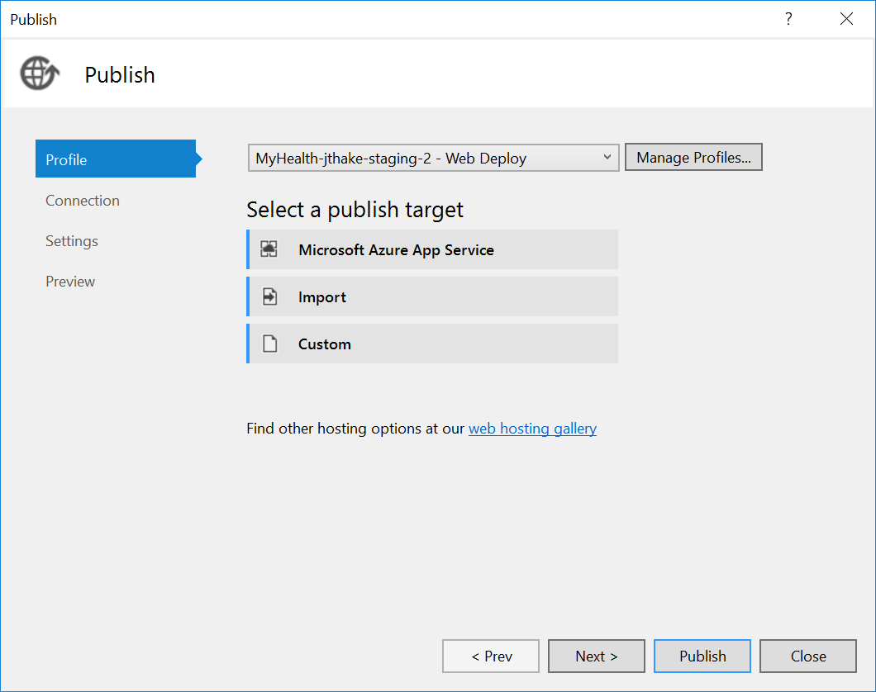
A seamless developer experience
Enterprise-grade apps
Fully managed platform
High productivity development

Slide 13
Demo
Notes:
Creazione progetto web vuoto asp.net
Publish
Debug da Cloud Explorer
- Creazione progetto core 2.0 e Docker
Creazione progetto core 1.1 e git https://docs.microsoft.com/en-us/azure/app-service/app-service-deploy-local-git
git init
git add –A
git commit -m "Hello Azure App Service VSLA“
Enable the App Service app repository
Deployment Options
Deployment Credentials
Properties
git remote add azure https://<username>@<webapp>.scm.azurewebsites.net:443/localgitdeployment.git
git push azure master
Deployment Options

Slide 14
Containers
Lightweight alternative to virtual machines
Smaller, less expensive, faster to start up, and self-contained
Virtual Machines
App
App
App
Libraries
Libraries
Libraries
Containers
Guest OS
Guest OS
Guest OS
App
App
App
Libraries
Libraries
Libraries
Hypervisor
Container Engine
Host Operating System
Operating System
Notes:
A virtual machine is -- well -- a virtualized machine created and managed by a hypervisor such as VirtualBox or Hyper-V. Even though a VM runs on a machine that has an operating system, each VM requires its own complete operating system, even if it's the same operating system as the host OS. VMs offer a very high degree of isolation, but at a cost: longer startup times, lower portability (ever tried to move a 127 GB virtual hard disk, or VHD, from one PC to another?), and higher memory requirements. Containers, by contrast, leverage the operating system that is already in place but offer nearly as much separation. RAM requirements are lower since the OS isn't being duplicated in each container, and cost is lower, too, because while cloud platforms typically charge for each VM, a single VM can host multiple container instances.

Slide 15
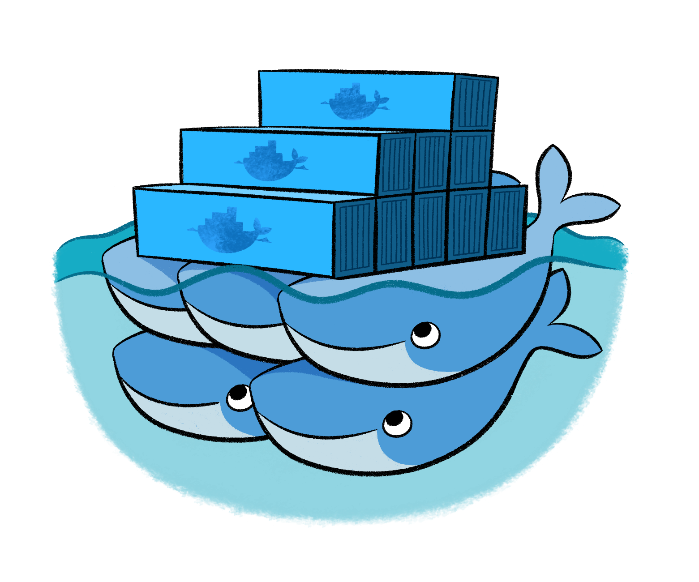
Docker
Leading open-source containerization platform
Supported natively in Azure
Docker containers wrap up a piece of software in a complete filesystem that contains everything it needs to run: code, runtime, system tools, system libraries – anything you can install on a server. This guarantees that it will always run the same, regardless of the environment it is running in
Notes:
Docker (www.docker.com) isn't the world's only containerization platform, but it is the most popular. It is free, open-source, and Linux-based, with Windows support (Windows Server 2016) in the works. It has earned massive mindshare in the developer community. And with Azure Container Service, you can deploy Docker containers to Azure with minimal effort. Moreover, Docker containers are easily moved between Azure and Amazon Web Services (AWS), affording developers portability between cloud platforms.

Slide 16
Demo
Notes:
Creazione progetto web vuoto asp.net
Publish
Debug da Cloud Explorer
- Creazione progetto core 2.0 e Docker
Creazione progetto core 1.1 e git https://docs.microsoft.com/en-us/azure/app-service/app-service-deploy-local-git
git init
git add –A
git commit -m "Hello Azure App Service VSLA“
Enable the App Service app repository
Deployment Options
Deployment Credentials
Properties
git remote add azure https://<username>@<webapp>.scm.azurewebsites.net:443/localgitdeployment.git
git push azure master
Deployment Options

Slide 17
SERVeRLESS
Azure Functions - Demo

Slide 18
What is Serverless?
$
Abstraction of servers
Event-driven
Micro-billing

Slide 19
Benefits of Serverless
Automatically Scale
Focus on business logic
Faster time to market

Slide 20

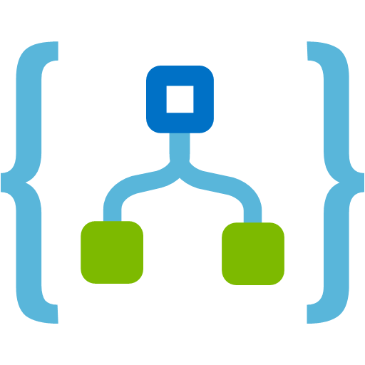
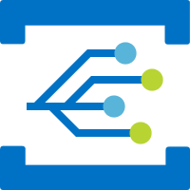
Serverless Components in Azure
Functions
Logic Apps
Event Grid
Serverless Compute
Serverless Workflow
Serverless Events

Slide 21


Azure Functions
Code
Azure Functions
Events + data
Notes:
Azure Stack
Open source

Slide 22
Demo
Notes:
TODO:

Slide 23
ARM – Resource manager
Demo

Slide 24
demo
Notes:
TODO:

Slide 25
resources
https://azure.microsoft.com/it-it/free/free-account-faq/
https://azure.microsoft.com/en-us/services/app-service/
https://azure.microsoft.com/en-us/services/functions/
Notes:
TODO:

Slide 26
Thank you.
DotNetToscana
Dotnettoscana.org
Riccardo Cappello
Microsoft MVP – Microsoft Azure

